Slide 1
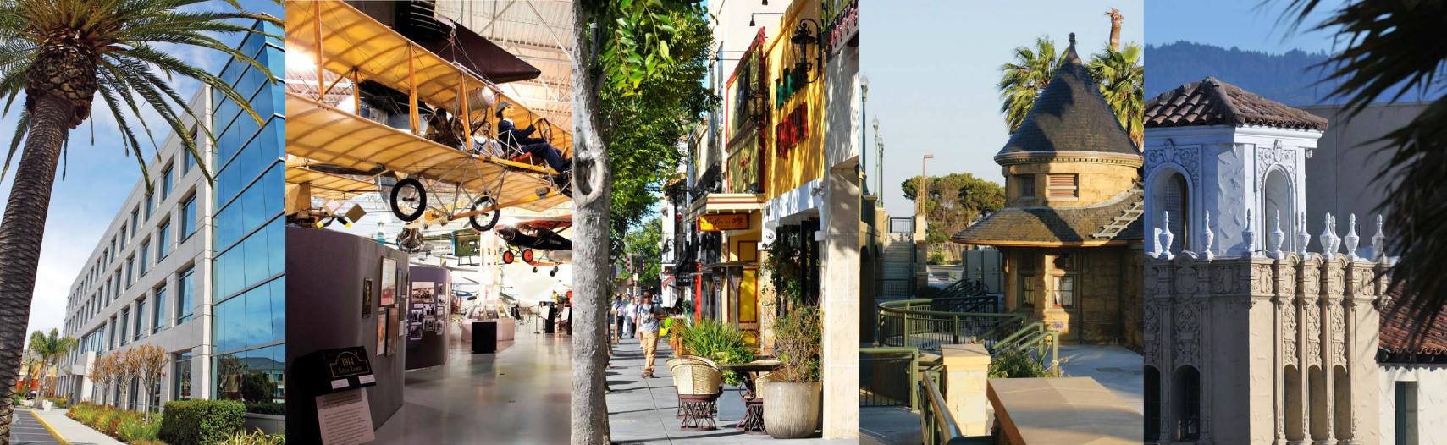
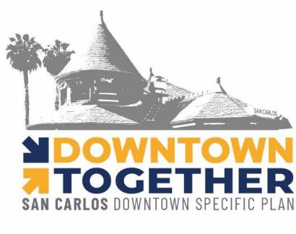

CITY OF SAN CARLOS
DOWNTOWN SPECIFIC PLAN PLAN PROJECT
www.sancarlosdowntownplan.com
Downtown Advisory Committee (DTAC) Meeting #4 | 6:30 PM – 8:00 PM
January 25, 2023
Notes:
Good evening DTAC members,
Its nice to see you all here on our first meeting! As a reminder, my name is Lisa Porras, Planning Manager and project manager for the Downtown Specific Plan project.
I am going to be walking us through tonight’s agenda. As an official Brown Act committee, we have certain protocols we must follow and I will guide us through those tonight.

Slide 2
DTAC Meeting Agenda
1. Meeting Kick-Off
Notes:
The first step is to officially start, or kickoff the meeting, which we will now do.
For all DTAC members, please make sure your camera is on throughout the duration of tonight’s meeting.

Slide 3

Pledge of Allegiance
“I pledge allegiance to the flag of the United States of America, and to the republic for which it stands, one nation under God, indivisible, with liberty and justice for all.”
Notes:
The next step is to conduct the Pledge of Allegiance.
So, if you can all please join me in reciting the Pledge of Allegiance.

Slide 4
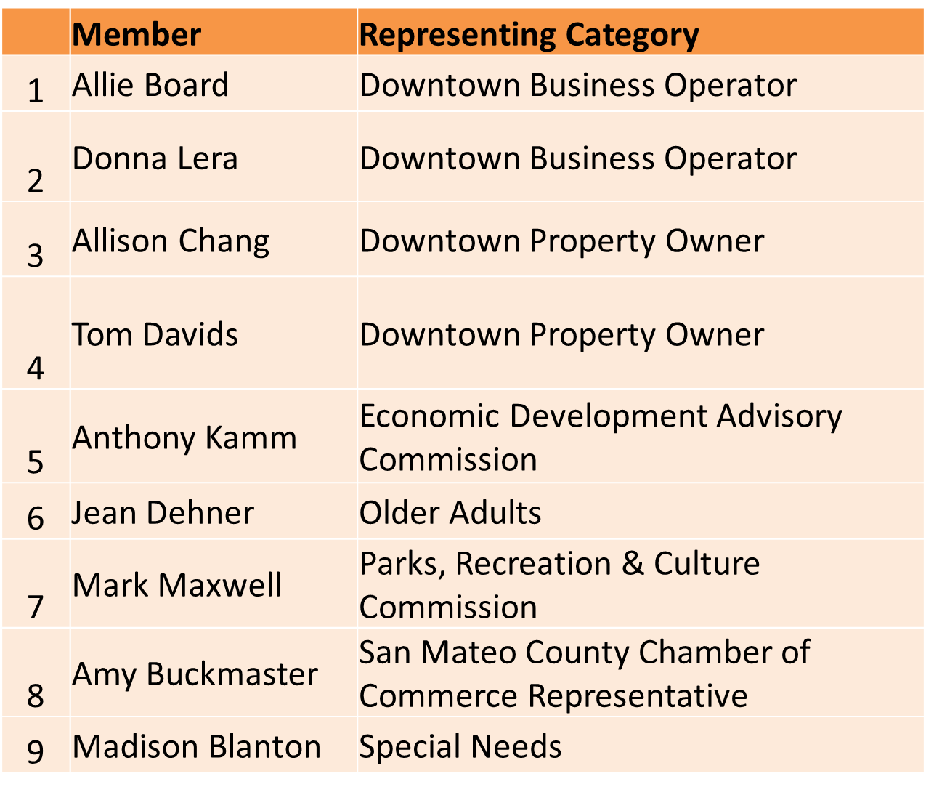
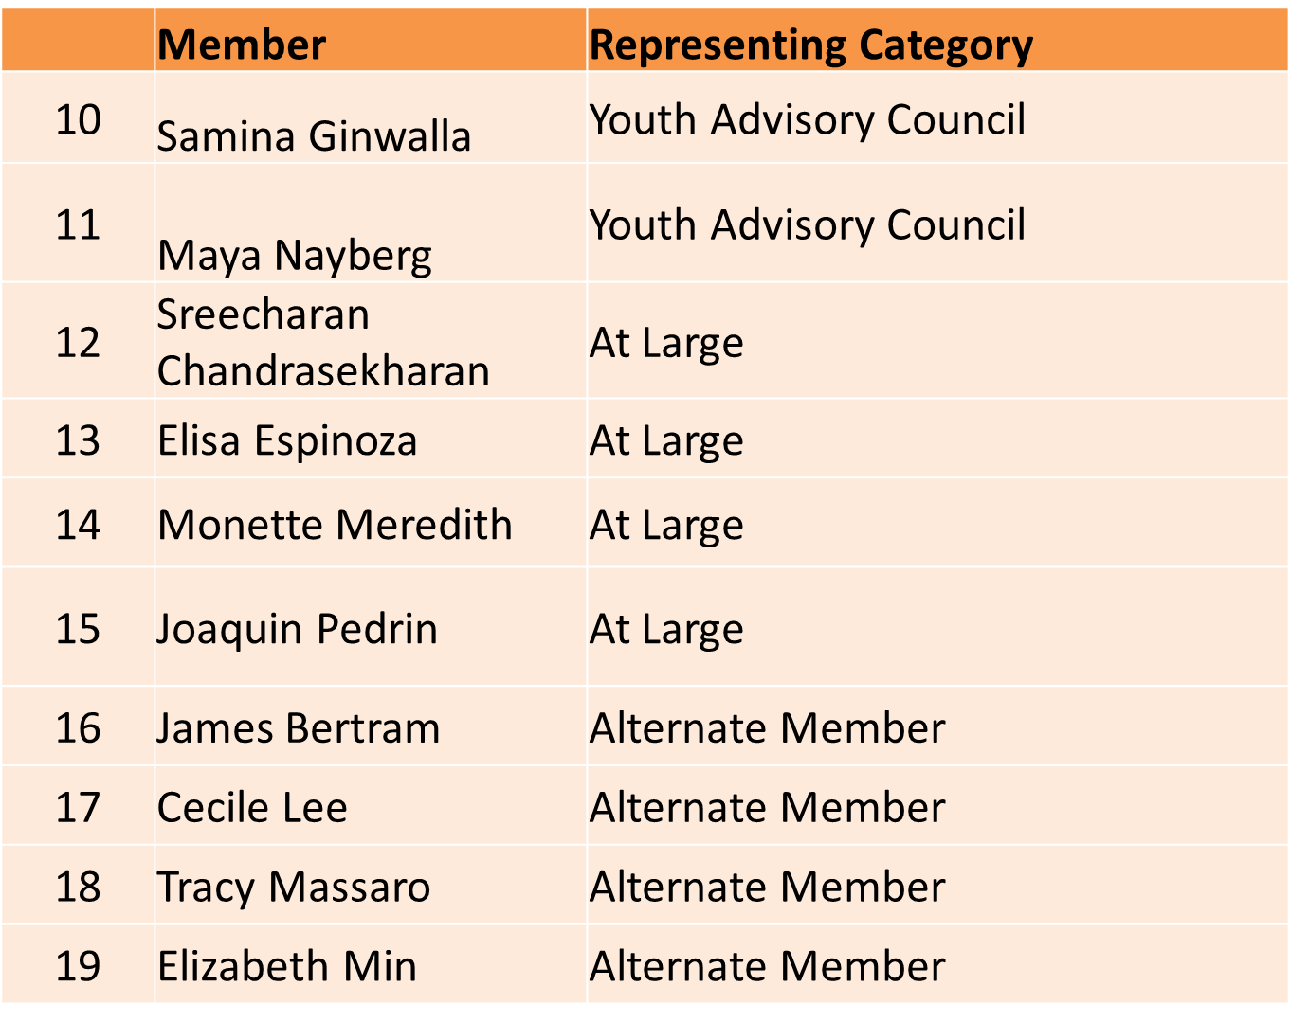
DTAC Attendance
Notes:
The next item on the Agenda is to conduct a record of attendance for this meeting.
I will call off your name, please unmute yourself and when I call your name and simply respond “HERE.”

Slide 5

DTAC Meeting Agenda
4. Discussion Items
Welcome
Project overview/update
Urban Design/Placemaking Concepts
  Laurel Street 700 block
  Public Space Elements
  Alley Improvements
Next Steps
Notes:
As I run through and finish each agenda item, I will take any questions the DTAC has.

Slide 6


Tonight’s Presenters
Lisa Porras, AICP
Planning Manager, Advance Planning
City of San Carlos
Jami Williams
Principal, RRM Design Group
Katja Dillmann
Senior Planner, RRM Design Group

Slide 7

Project Refresher

Slide 8
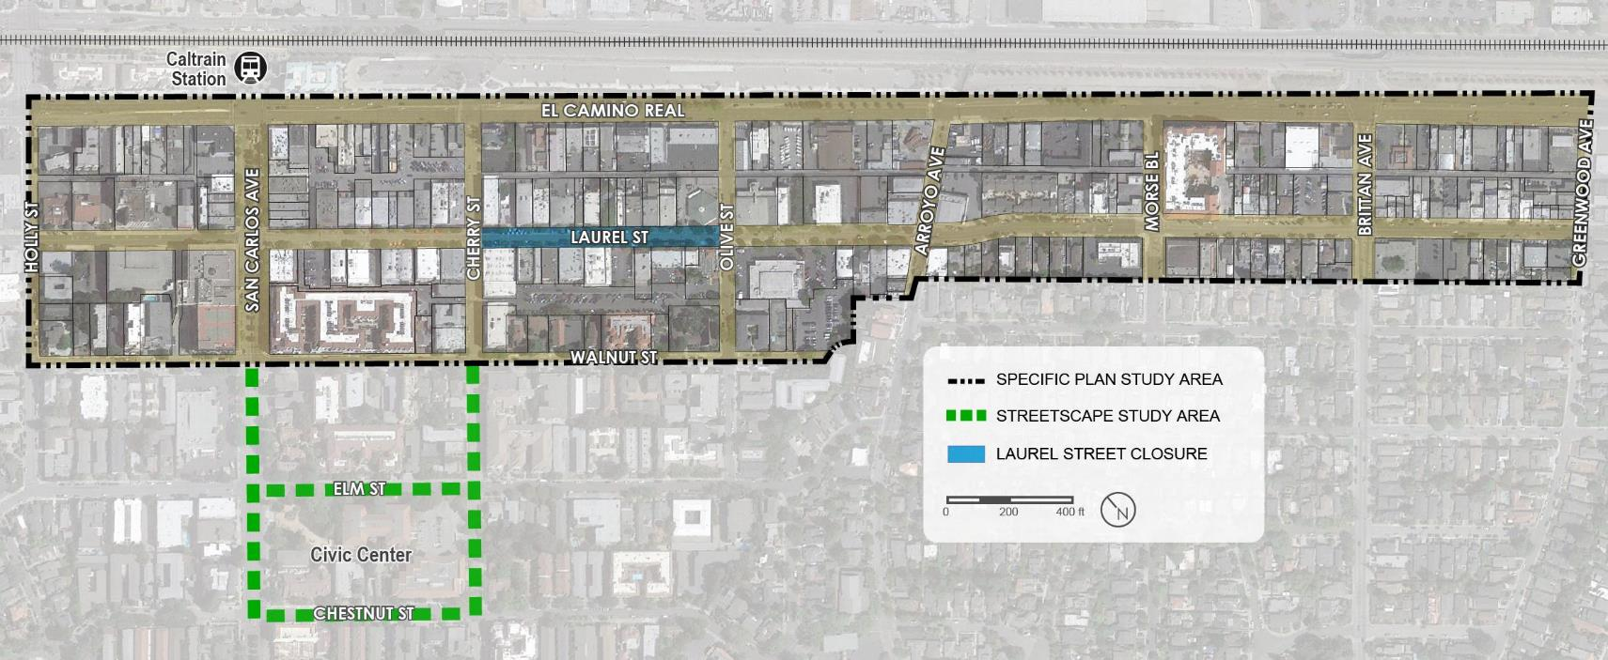
Specific Plan Area

Slide 9
What is a Specific Plan?
  General Plan
    City’s long-term vision for the future
    Goals, policies, objectives that guide physical development
  Zoning Ordinance
    Establishes land uses and development standards
    Specific Plan
    Must be consistent with General Plan
    Provides a vision and direction for a specific area
    Provides a customized regulatory framework
    Takes precedence over standards set by the Zoning Ordinance
GENERAL PLAN
ZONING CODE
SPECIFIC
PLAN

Slide 10
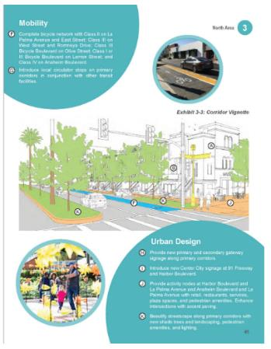
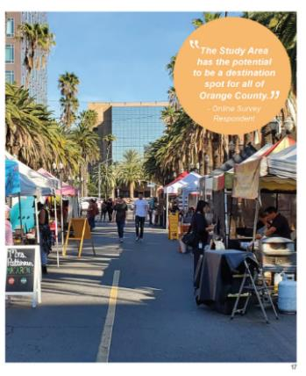
What is a Specific Plan?
  Establishes:
    Private Realm – land uses and development standards
    Public Realm – mobility, streetscape beautification, plaza, alley, and infrastructure improvements and urban design concepts
    Implementation actions and programs
    Development approval authority, processes, and streamlining

Slide 11
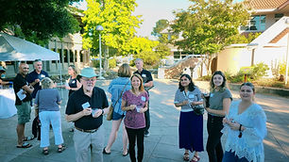
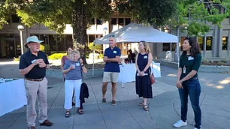
Public Engagement To Date
Stakeholder Meetings and Focus Groups
City Council Member 1-on-1 Meetings
3 DTAC Meetings
  June 22, 2022: orientation, roles and responsibilities
  July 13, 2022: Reimagining Main Street, What Makes Downtown Special, Ice Cream Social
  Sept. 13, 2022: existing conditions analysis and discussion
Community Workshop (August 2022)

Slide 12
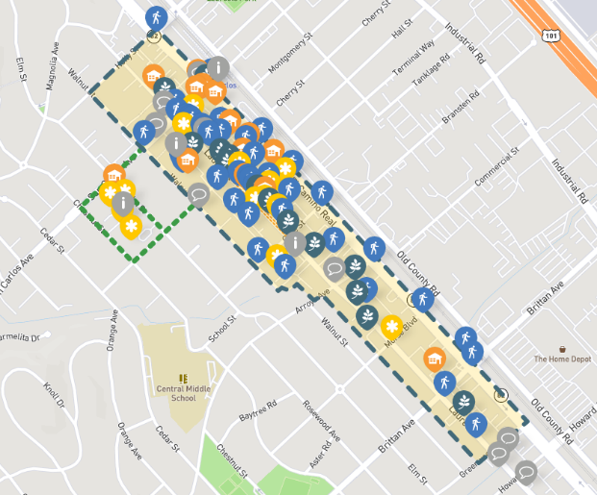
Public Engagement – Online
Online Interactive Map: Social Pinpoint (Closed Sunday Jan. 15, 2023)
  470 Comments
    Mobility: 163
    Streetscape: 83
    Gathering Spaces: 75
    Allowable Uses: 64
    Other: 85

Slide 13
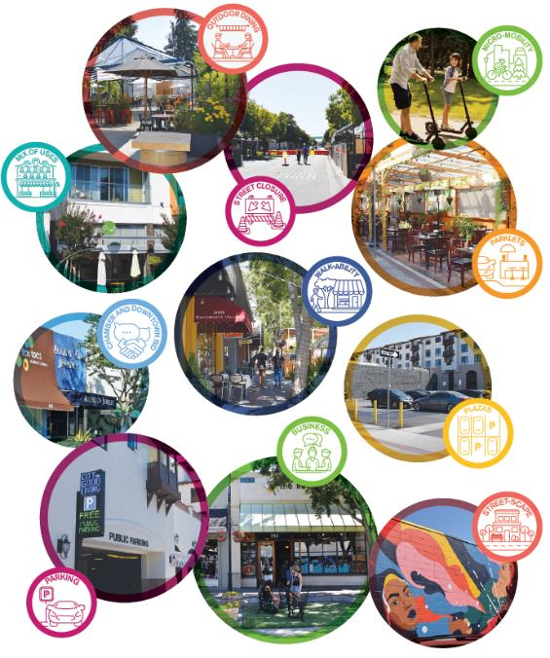
Public Engagement – What We Heard
Beautification, street trees & landscaping
  Make street closure more attractive
  and permanent
  Additional outdoor gathering/seating areas
  Support for outdoor dining
  Laurel Plaza
  Enhance alleyways
  Improve sidewalks

Slide 14
Urban Design and Placemaking Concepts

Slide 15
Urban Design / Placemaking
Discussion Points:
  Street Closure on 700 Block of Laurel
  Public Space Elements
  Alley Improvements

Slide 16
Laurel Street

Slide 17
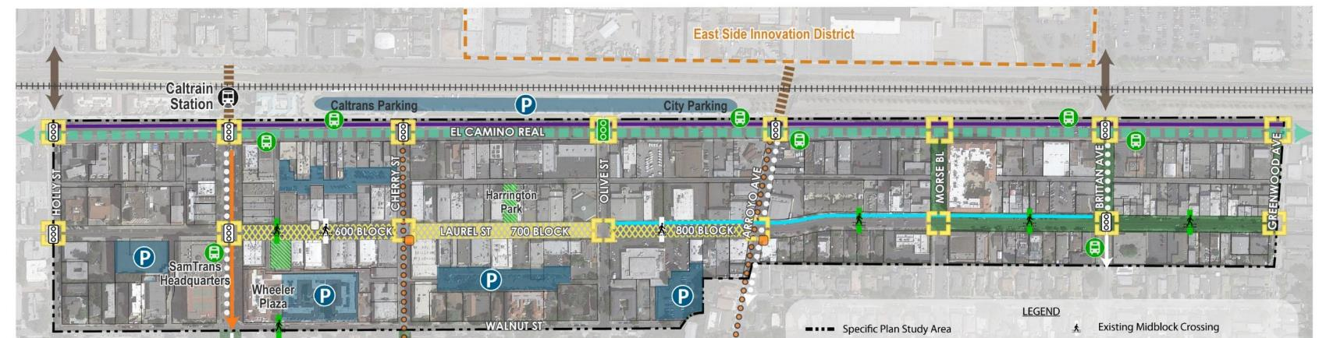
Laurel Street – 700 Block
Today’s Decision – 700 Block
FUTURE DECISIONS FOR THE REST OF LAUREL (600 & 800)
  Extend Street Closure to San Carlos
  Extend Street Closure to Arroyo
  Extend Street Closure to San Carlos and Arroyo
1
2
3
1
2
3

Slide 18
Laurel Street – 700 Block, 4 Options
  Flexible Closure Option:
  Temporary in nature, spruced up but removable
  Widen Sidewalk Option:
  Widen sidewalk, two travel lanes, parallel parking
  Plaza Option:
  Full Closure as Plaza Concept
  Pre-2020 Option:
  Eliminate Street Closure – open to cars as it was pre-pandemic

Slide 19
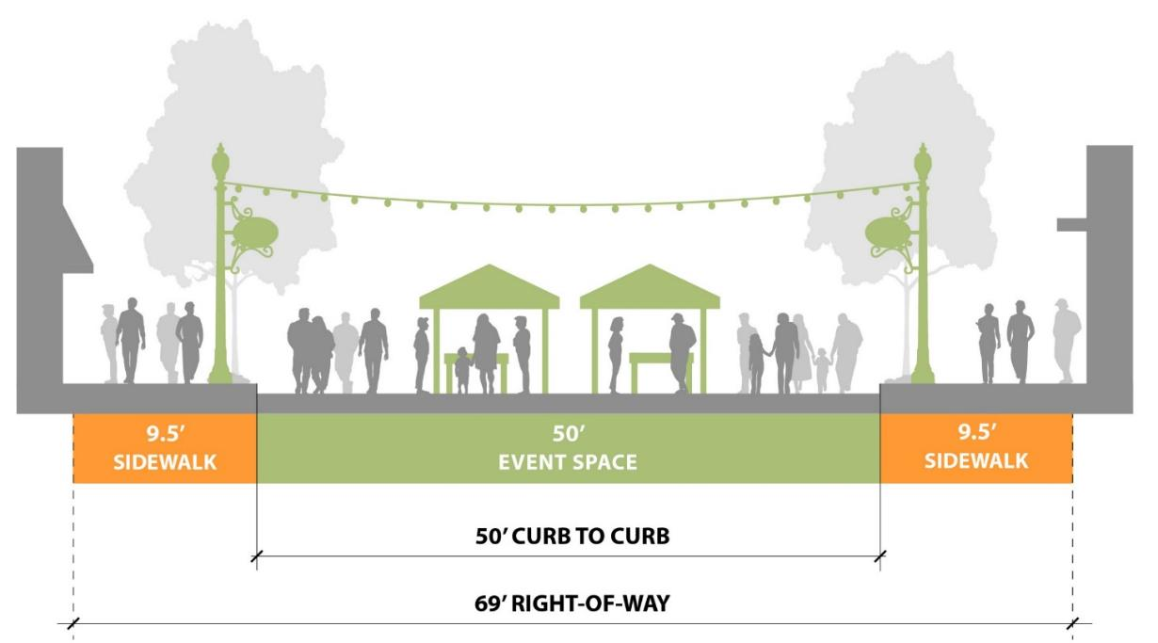
Laurel Street – 700 Block – Flexible Closure
  Flexible Closure Option: Temporary but spruced up
  New street furnishings and lighting, possible intermittent hours or events
Notes:
Traffic disruption is ~2 cars/minute at peak hour
63 parking spaces – represents 9% of on-street spaces north of Arroyo and 3% of the total spaces north of Arroyo

Slide 20
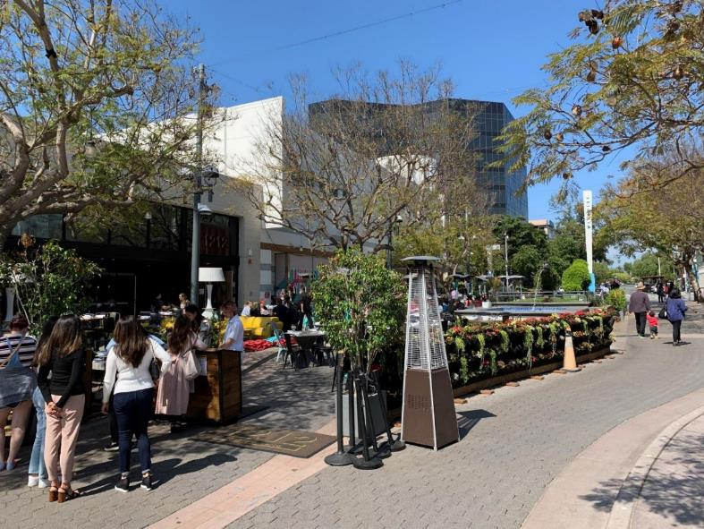
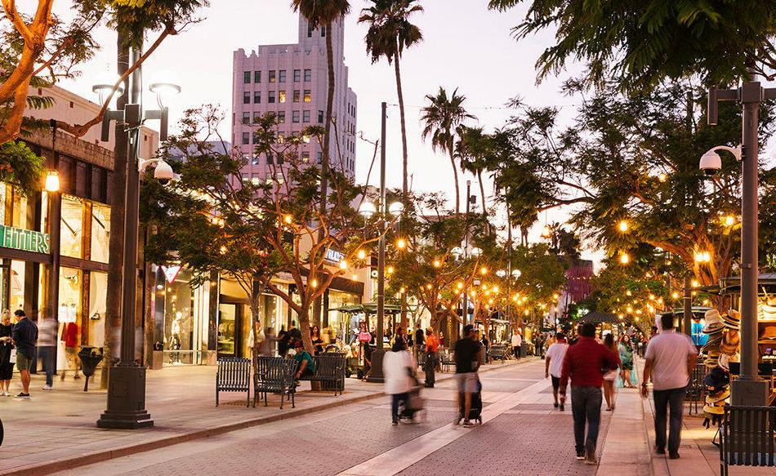
Laurel Street – 700 Block – Flexible Closure
  Flexible Closure Option: Temporary but spruced up
Source: Al Savay
Source: Al Savay
Notes:
Traffic disruption is ~2 cars/minute at peak hour
63 parking spaces – represents 9% of on-street spaces north of Arroyo and 3% of the total spaces north of Arroyo

Slide 21
Laurel Street – 700 Block – Flexible Closure
Flexible Closure Option
Advantages:
Maximum Flexibility
Allows a variety of businesses to activate space on a temporary basis
Facilitates community-building
Improves pedestrian access during temporary closures
Trade-Offs:
Loss of 63 parking spaces
Lacks full benefits of permanent street closure
Intermittent traffic disruption - motorists must remember closure if hours are changed
Notes:
Traffic disruption is ~2 cars/minute at peak hour
63 parking spaces – represents 9% of on-street spaces north of Arroyo and 3% of the total spaces north of Arroyo

Slide 22
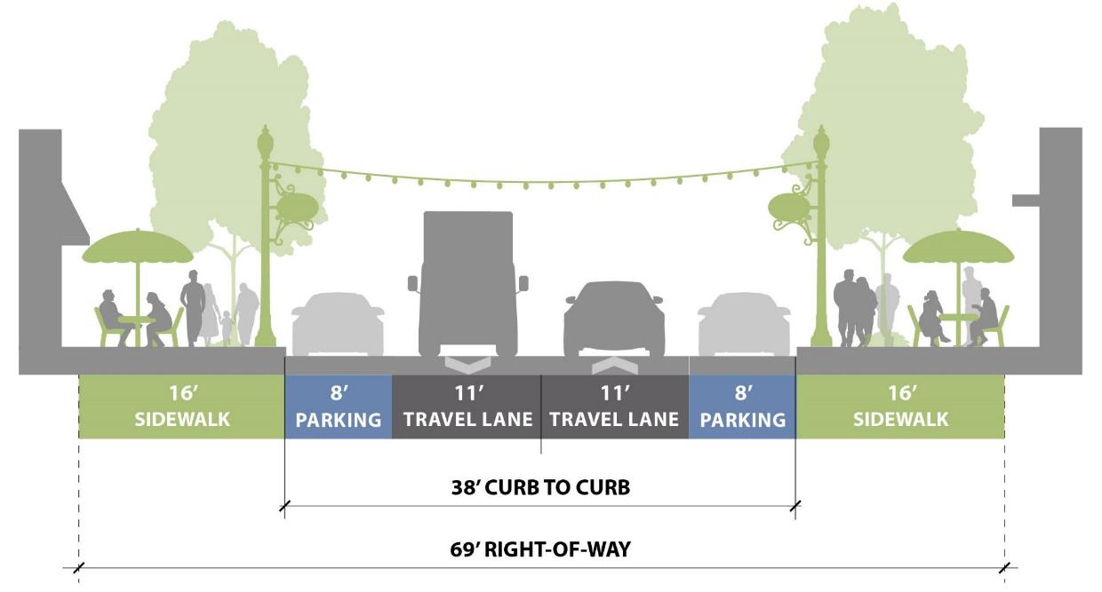
Laurel Street – 700 Block, Widened Sidewalk
  Widened Sidewalk Option:
  Enhanced Pedestrian environment, two travel lanes, retains some parking

Slide 23
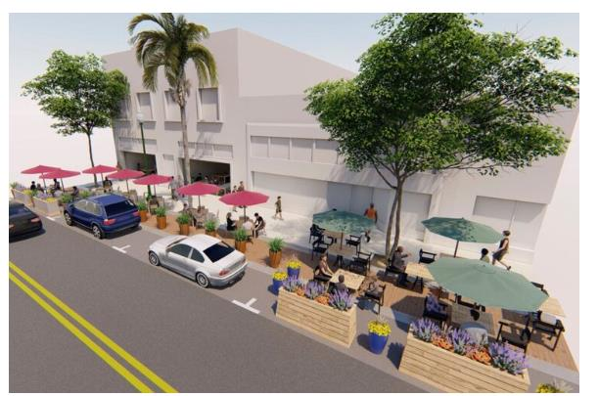
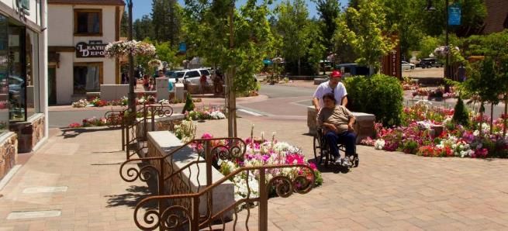
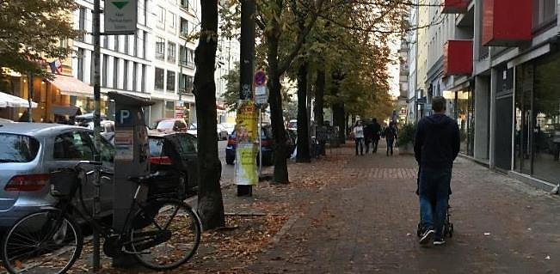
Laurel Street – 700 Block, Widened Sidewalk
  Widened Sidewalk Option:
  Two travel lanes, retains some parking
Source: City of Ventura
Source: Katja Dillmann

Slide 24
Laurel Street – 700 Block, Widened Sidewalk
Widened Sidewalk Option
Advantages:
Expanded sidewalks with street furniture and lighting
Pedestrians are retail adjacent
Additional room for sidewalk dining
Maintains vehicle access and adjacent parking
Trade-Offs:
Loss of large community space
Loss of 20 parking spaces
Notes:
Traffic disruption is ~2 cars/minute at peak hour
63 parking spaces – represents 9% of on-street spaces north of Arroyo and 3% of the total spaces north of Arroyo

Slide 25
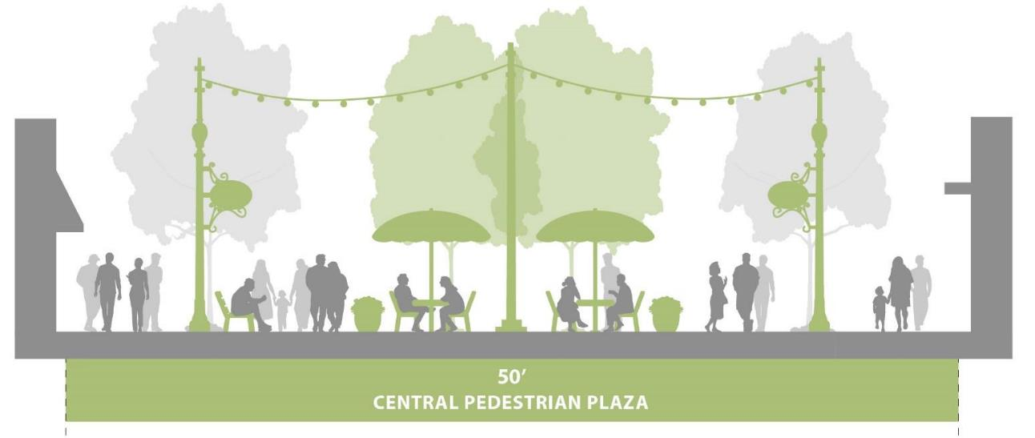
Laurel Street – 700 Block – Plaza
  Plaza Option: Full closure, space is converted into a Plaza

Slide 26
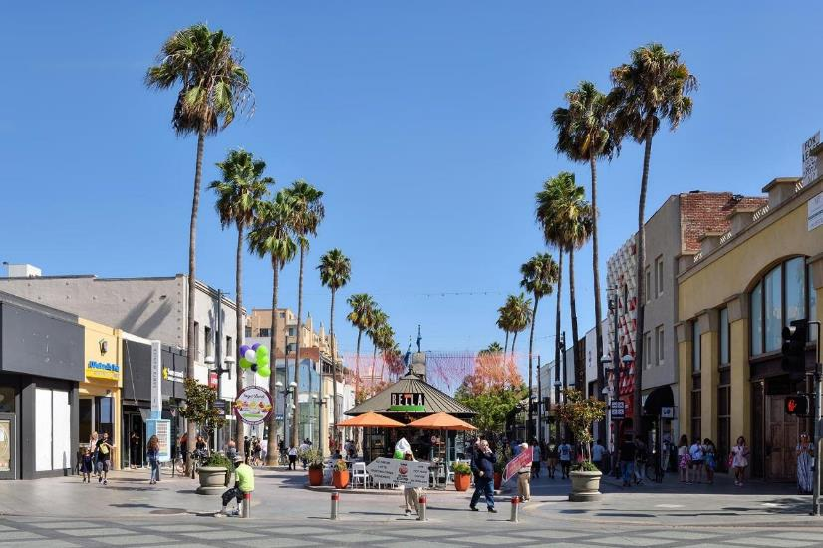
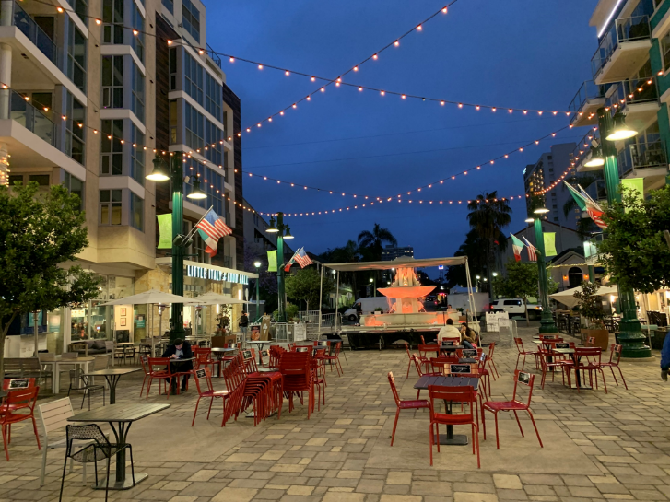
Laurel Street – 700 Block – Plaza
  Plaza Option: Full closure, space is converted into a Plaza
Source: Al Savay
Source: Al Savay

Slide 27
Laurel Street – 700 Block – Plaza
Plaza Option
Advantages:
Dedicated community space
Downtown plaza becomes a destination
More space for retail, dining, and public space
No limits on amenities, lighting, and special paving
Trade-Offs:
Loss of 63 parking spaces
Delivery required from alley
No vehicle visibility
Minor traffic disruption
Potential emergency access delays
Notes:
Traffic disruption is ~2 cars/minute at peak hour
63 parking spaces – represents 9% of on-street spaces north of Arroyo and 3% of the total spaces north of Arroyo

Slide 28
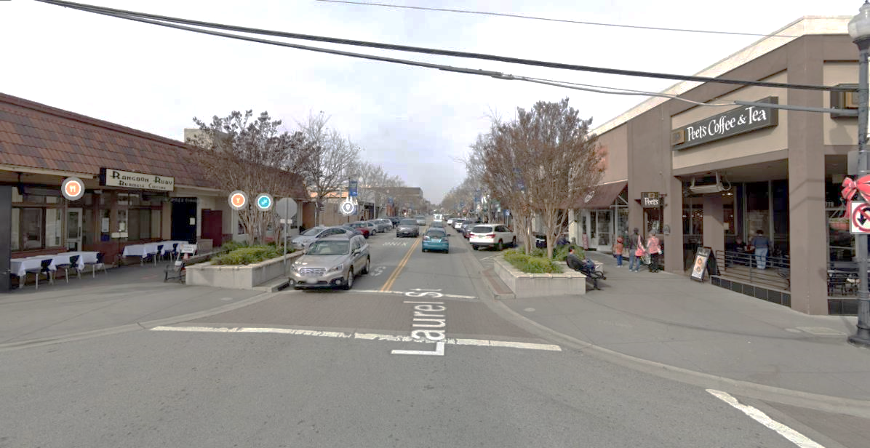
Laurel Street – 700 Block, Pre-2020 Option
  Pre-2020 Option: Eliminate Street Closure
  Open to cars as it was pre-2020

Slide 29
Laurel Street – 700 Block, Pre-2020 Option
Pre-2020 Option
Advantages:
No loss of parking
No new impact on how motorists navigate the Downtown
No user confusion
Trade-Offs:
Lose a community asset
Lose outdoor dining opportunity
Lose flexibility of using space
Notes:
Traffic disruption is ~2 cars/minute at peak hour
63 parking spaces – represents 9% of on-street spaces north of Arroyo and 3% of the total spaces north of Arroyo

Slide 30
Polling Exercise

Slide 31
Laurel Street – 700 Block, 4 Options
  Flexible Closure Option:
  Temporary in nature, spruced up but removable
  Widen Sidewalk Option:
  Widen sidewalk, two travel lanes, parallel parking
  Plaza Option:
  Full Closure as Plaza Concept
  Pre-2020 Option:
  Eliminate Street Closure – open to cars as it was pre-pandemic

Slide 32
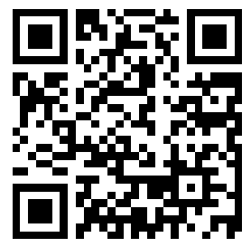
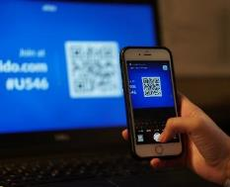
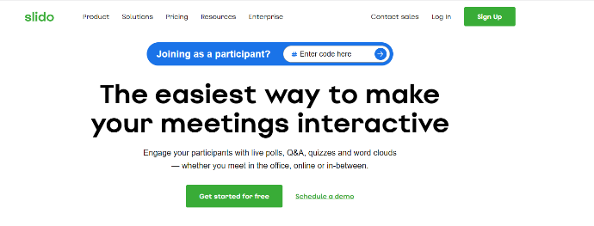
Participate in a Live Poll on Slido.com
DTAC Meeting Agenda
There are two ways to join:
OPTION 1:
OPTION 2:
Join via web browser by going to slido.com and typing in the event passcode: 1793969
Join via your smart phone by opening your camera app and scanning the survey QR code
Join via your smart phone by opening your camera app and scanning the survey QR code

Slide 33
Tell us!
Which is your preferred 700 block option?
  Flexible Closure
  Widened Sidewalk
  Plaza Option
  Pre-2020 Option
I would go downtown more often (select 2):
  If there was a permanent plaza, public gathering spaces
  If there were wider sidewalks with adjacent parking
  If I could drive down the 700 block, like before 2020
  For Farmer’s Market and special events
  Other

Slide 34
Tell us!
I would like to see more of the following in Downtown (select all that apply):
  Outdoor dining
  Street furnishings
  Plazas
  Public Art
  Wayfinding
  Street trees
  Bicycle Parking
  Other
What types of programs or entertainment would you like to see downtown (select all that apply):
  Music events
  Kid friendly programs
  Theater/Performance pop up events
  Cultural or art exhibits
  Movies on the plaza/square
  Activities/yoga, tai chi, qi gong
  Chess, backgammon, game night

Slide 35
Discussion

Slide 36
Public Space Elements

Slide 37
Public Spaces
  Laurel/Wheeler Plaza
  Harrington Park

Slide 38
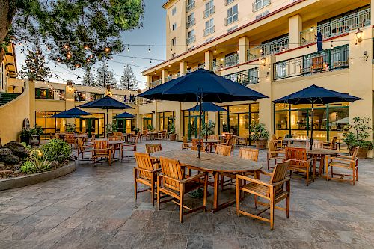
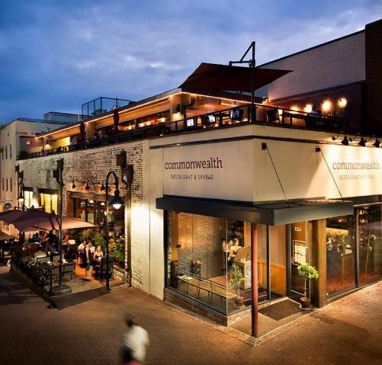
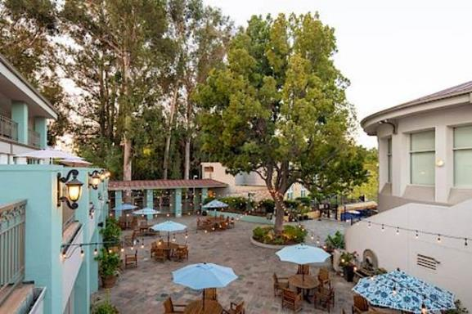
Laurel Plaza
  Retail/Restaurant Development with
  Smaller Plaza
Source: Al Savay
Source: City of San Carlos
Source: Al Savay

Slide 39
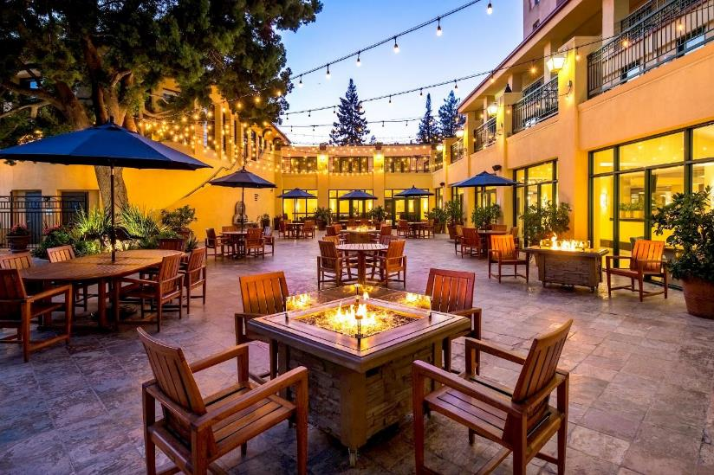
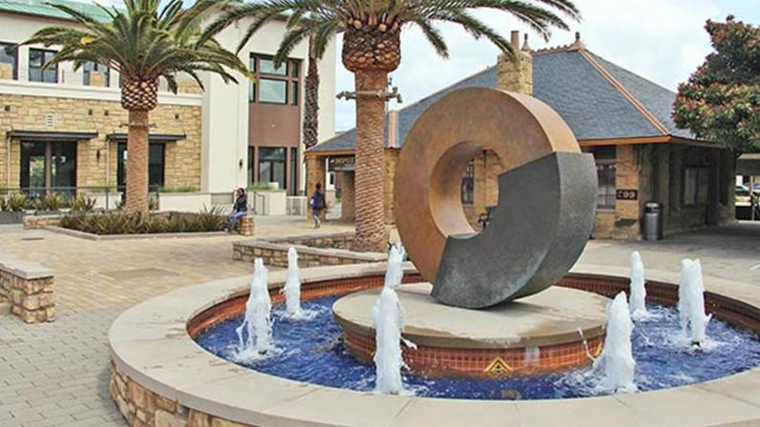
Laurel Plaza
  Large Plaza Space
Source: Wheeler Plaza Conceptual Plans
Source: Al Savay
Source: iStock
Notes:
Source: iStock photo

Slide 40
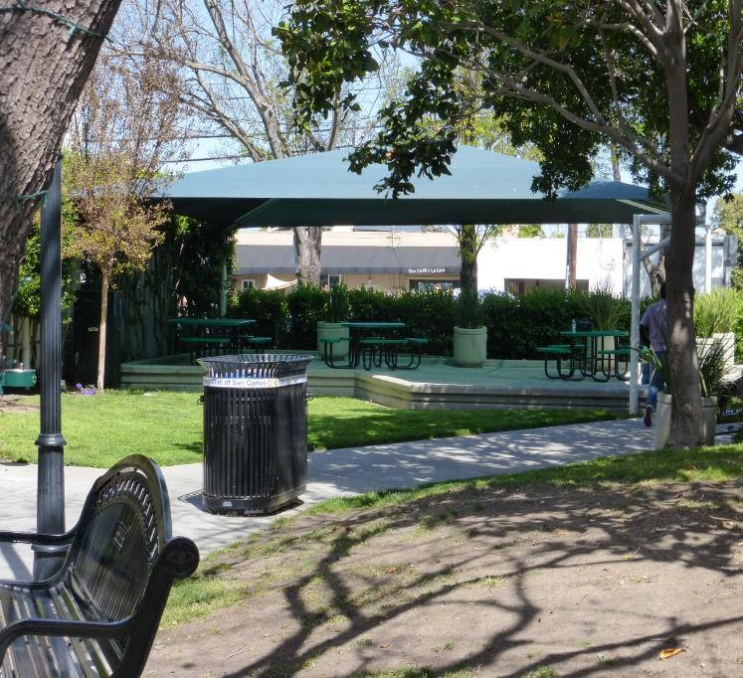
Harrington Park Concepts
  Park and Plaza
  All Plaza
  Music/stage

Slide 41
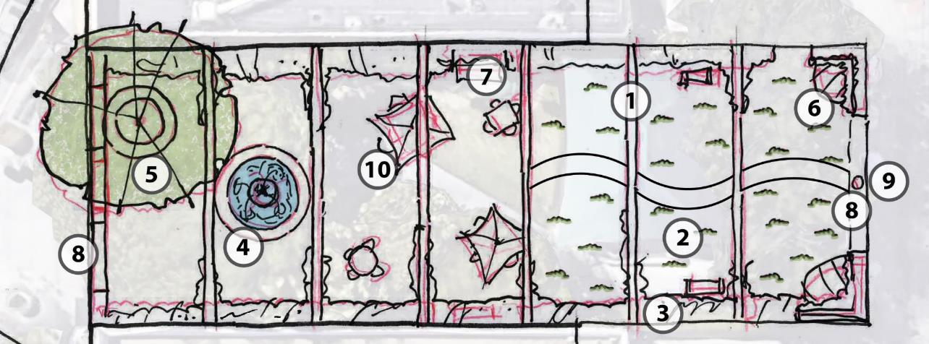
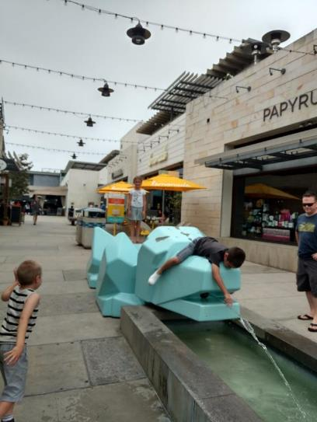
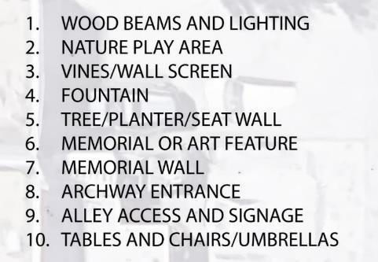
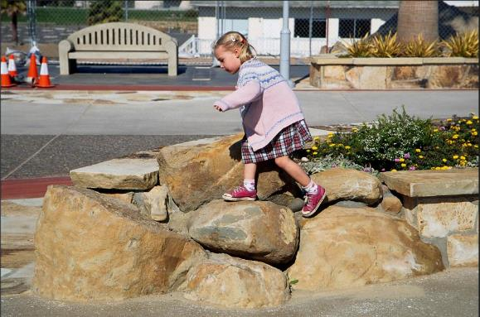
Harrington Park – Park & Plaza

Slide 42
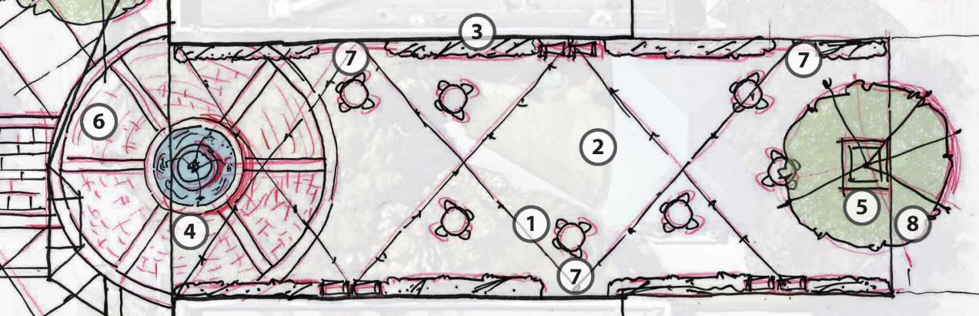

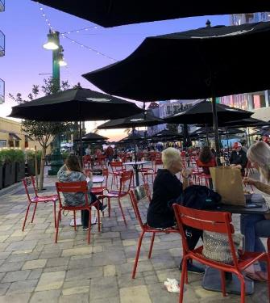
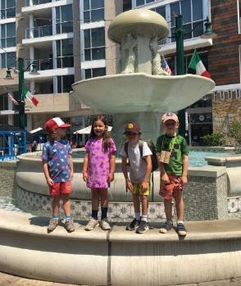
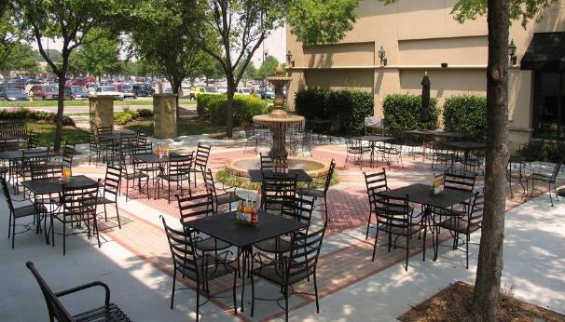
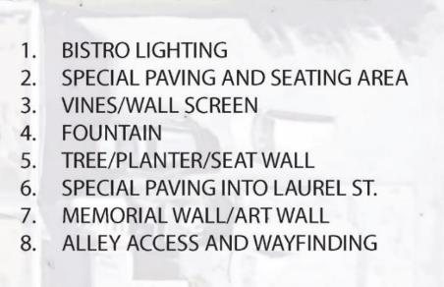
Harrington Park – All Plaza

Slide 43
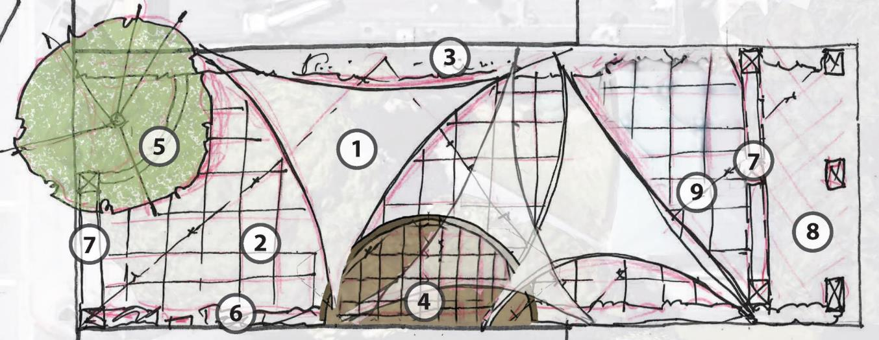
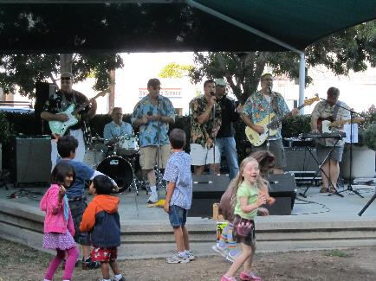
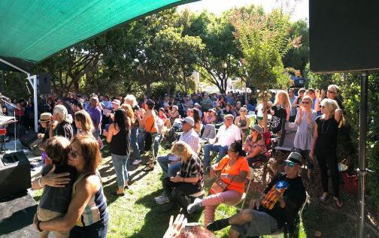
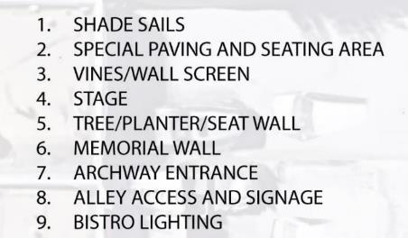
Harrington Park – Music/Stage

Slide 44
Possible Public Space Elements
Lawn or landscaping
Movable furniture (tables, chairs, umbrellas)
Public art
Area where children can play
Fountain/ Water feature
Tree canopy
Open air with some shade covering
Stage/music venue
Bistro lighting

Slide 45
Polling Exercise

Slide 46
Tell us!
What is your highest priority for public spaces in the downtown area?
  I want to people watch
  I want to go somewhere with my kids
  I want to be able to eat lunch outside
  I would like events and programs
Please rank the amenities in order of importance to you in the downtown core (#1 is the MOST important)
Lawn or landscaping
Movable furniture (tables, chairs, umbrellas)
Area where children can play
Fountain/ Water feature
Tree canopy
Open air with some shade covering
Stage/music venue
Bistro lighting

Slide 47
Discussion
Are there other elements we should consider?

Slide 48
Alley Improvements

Slide 49
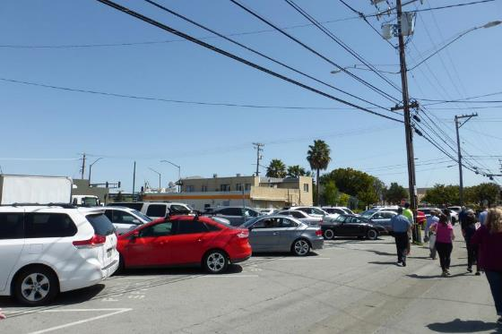
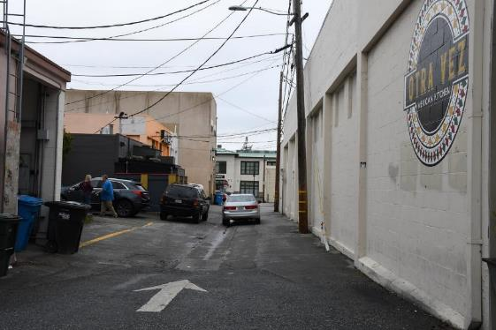
Alley Issues
Lack of wayfinding
No clear pedestrian path of travel
Service / delivery congestion
Individual trash receptacles clutter
Private / public parking confusion
Lack of bike parking and connectivity

Slide 50
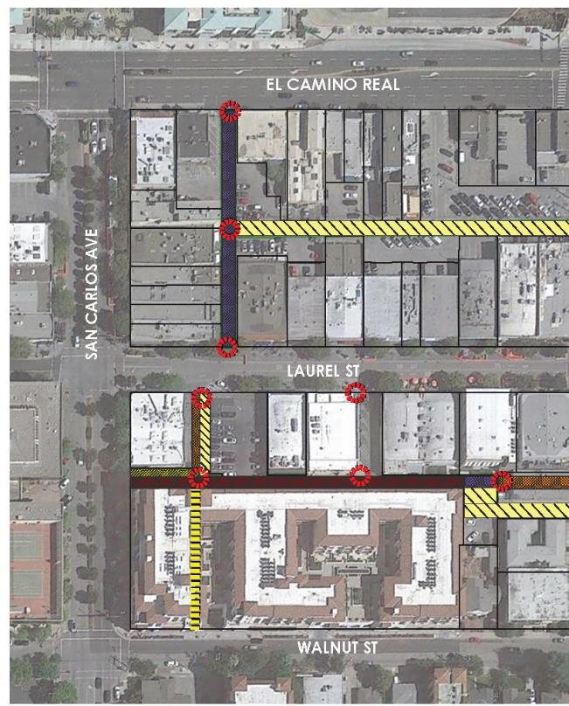
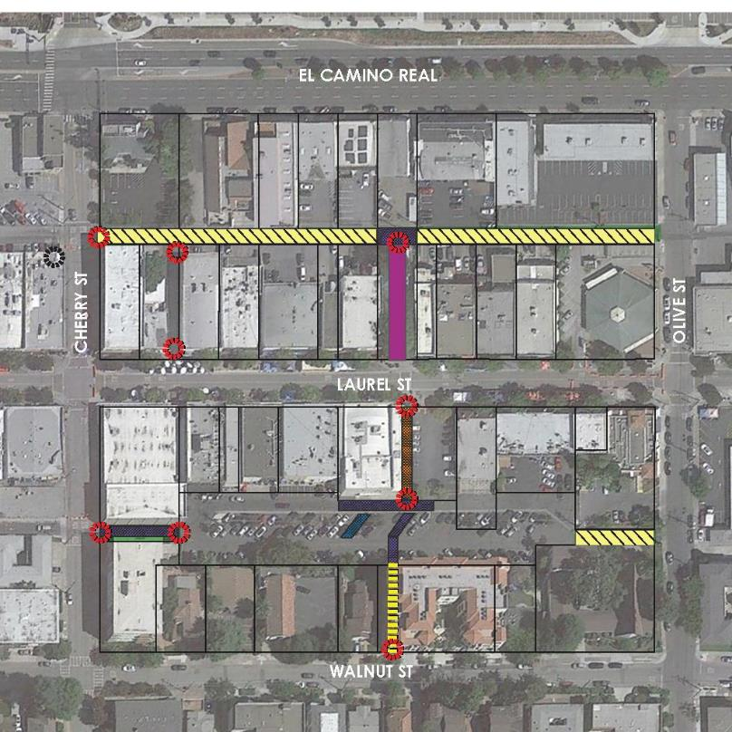
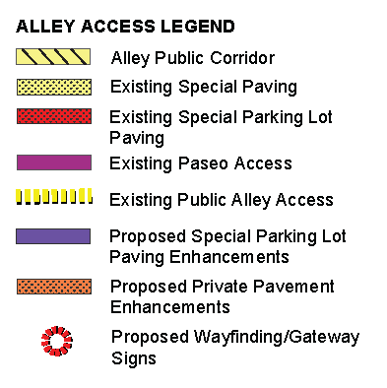
Alley Enhancement

Slide 51


Alley Enhancement
Decorative Wayfinding Signage
Special Parking Lot Paving
Level Sidewalk Crossing
D. Rolled Curb
E. Mural Wall Opportunity
F. Decorative Street Light
G. Truncated Dome

Slide 52



Alley Enhancement
Public Parking between Walnut & Laurel
Flush Concrete Curb
Special Parking Lot Paving – Pedestrian Path
Wayfinding Signage

Slide 53



Alley Examples
Source: RRM Design Group
Source: Google Maps
Source: Google Maps

Slide 54
Discussion
Are we on the right track?

Slide 55
Next Steps
Virtual Community Workshop February 15, 2023 @ 7 pm
Register at www.sancarlosdowntownplan.com

Slide 56

1/25 DTAC
2/15 workshop
March - Planning Commission and City Council Study Sessions

Slide 57
DTAC Meeting Agenda
5. Comments from the Public

Slide 58

DTAC Meeting Agenda
6. Wrap Up

Slide 59

Thanks for participating!
sancarlosdowntownplan.com
Contact Us: AdvancePlanning@cityofsancarlos.org

