Slide 1
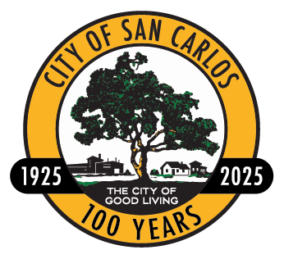
San Carlos Downtown Streetscape Master Plan
Agenda Item 11a
City Council
April 28, 2025

Slide 2
Project Team
City Staff Core Team
Al Savay, Community and Economic Development Director
Lisa Porras, Planning Manager
Rendell Bustos, Senior Planner
Hanieh Houshmandi, Senior Traffic Engineer
WRT
James Stickley, Principal, Landscape Architect and Urban Designer
Rohit Tak, Urban Designer
Poonam Narkar, Principal, Planner and Urban Designer

Slide 3
Agenda
Planning & Transportation Commission Recommendation
Project Summary
Downtown Vision and Guiding Principles
Downtown Core – Public Realm Design
Mid-Laurel and South Laurel (SoLa) Street
Alleys
Materials, Public Art, Green Infrastructure, Wayfinding
Phasing and Funding Strategies
Next Steps

Slide 4
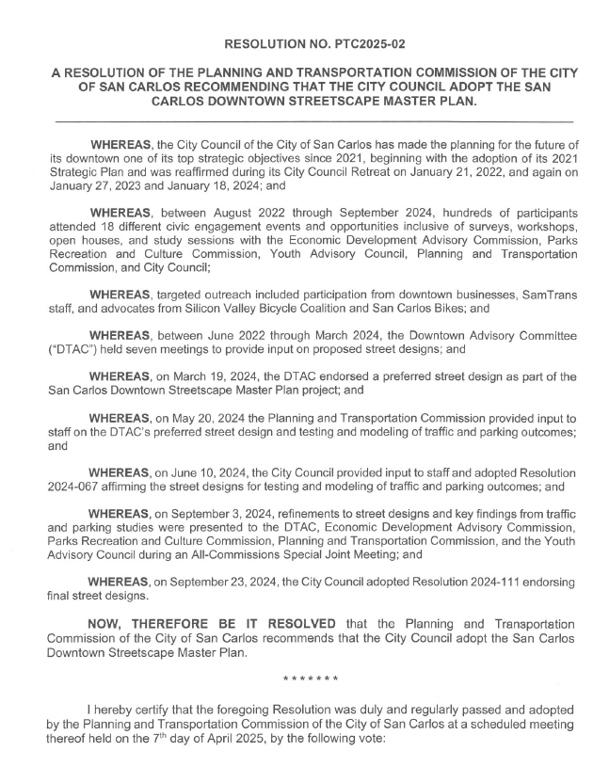
Planning and Transportation Commission Recommendation:
April 7, 2025, the Planning & Transportation Commission adopted Resolution No. 2025-02, recommending the City Council adopt the San Carlos Downtown Streetscape Master Plan.

Slide 5
Planning and Transportation Commission Comments:
Outdoor dining regulations
Vertical barriers for protected bicycle lanes
Green paint for bicycle lanes
Sharrow markings
Share the lane signage
Stormwater runoff (rain gardens)
Pavement markings – interface between street and plaza (600 Block)
EV charging/smart poles
Driveway at US Bank
Bicycle safety on Brittan
Phasing flexibility
Alleys during construction
Secondary entrances, trash improvements
Loading/deliveries
Underground utilities
Local tribes, artwork opportunities

Slide 6
The Project
In progress
Ready for adoption
San Carlos
Downtown Specific Plan
Goals
Policies
Standards
Implementation
Downtown Specific Plan
Adoption September 2025
Downtown Streetscape Master Plan
Adoption April 2025

Slide 7
The Streetscape Master Plan Document
Executive Summary
Chapter 1: Introduction
Chapter 2: Existing Traffic Network and Street Character
Chapter 3: Proposed Streetscape and Public Space Design
Chapter 4: Towards Implementation
Adopting the Downtown Streetscape Master Plan does not mean approving a streetscape design for construction. The Streetscape Plan provides a holistic and comprehensive guide for downtown transformation. Implementing improvements to each street, alley, and plaza requires design/engineering and City Council direction and oversight before any construction can occur.

Slide 8
The Vision
“Downtown is the heart of San Carlos that provides a vibrant, pedestrian-friendly, safe, charming, futuristic, and accessible destination for the community and strongly expresses its unique culture and heritage. It is a place for celebration and gathering that offers diverse and authentic experiences through a draw of food, retail, services, art and music in a visually attractive environment for the growing community. Downtown is an inclusive place with easy access for all, opportunities for housing and businesses of all types, and inviting spaces for all users. Downtown San Carlos is a sustainable district, with landscape that supports ecological and community health & well-being.”

Slide 9
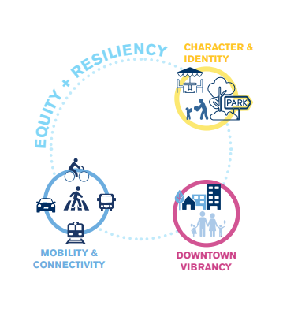
Guiding Principles
Balance and more equitable mobility modes.
Socially vibrant pedestrian-oriented environment
Distinctive character and identity unique to San Carlos’ culture, history, and context.
Vibrancy and vitality that consistently attracts users and shoppers in a setting that is distinctive, safe, and attractive.
Equitable place offering social, economic, housing and recreational opportunities at varying levels of affordability for all users along with being resilient to address evolving climate adaptation needs.

Slide 10
CIVIC ENGAGEMENT

Slide 11
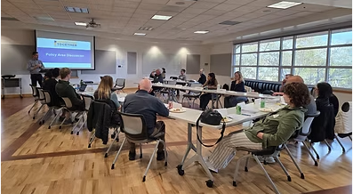
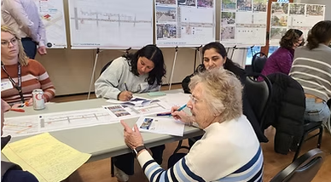
Downtown Advisory Committee (DTAC)
7 mtgs
1 All-Commissions mtg
Endorsed street designs on March 19, 2024
Revisited final designs on September 3, 2024 prior to City Council endorsement.

Slide 12
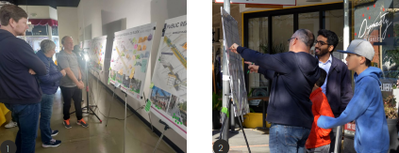
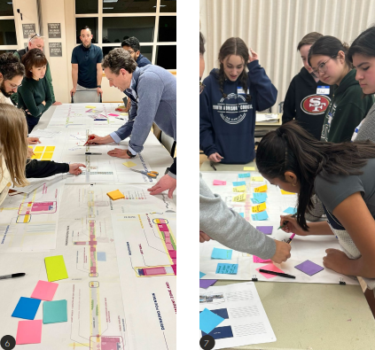
Community Engagement
Stakeholders Focus Group Interviews: August 2022
Survey 1: August 2022 – January 2023
Workshop: August 2022
Workshop: February 2023
Coffee and Comments Open House: March 2023
Survey 2: March 2023 – April 2023
Project Updates to PTC and CC: April 17 and 24, 2023
Downtown Business Stakeholder Meeting: May 2023
Ideation Workshops: December 2023
Survey 3: December 2023 – January 2024
EDAC Meeting: January 2024
PRCC Meeting: February 2024
YAC: March 2024
PTC and CC: May, June 2024 (DTAC-endorsed street designs)
Downtown Business Stakeholder Meeting: August 2024
All Commissions Joint Meeting: September 2024
Survey 4: August 2024
CC Endorsement: September 2024

Slide 13
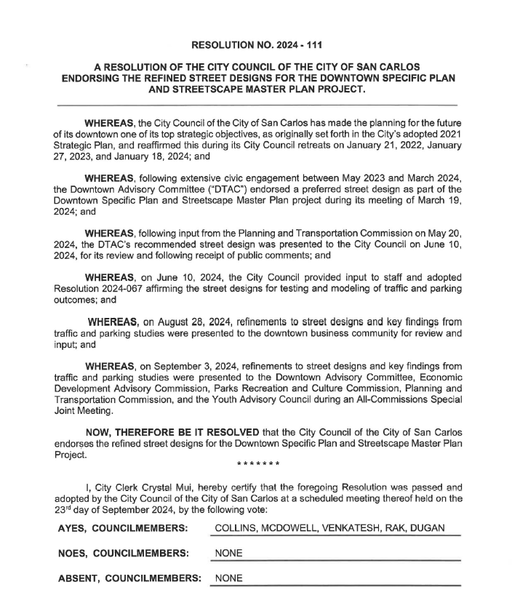
City Council Endorsement, Sept 23, 2024:
On September 23, 2024, a major milestone was reached when the City Council received the findings from the traffic and parking technical studies alongside the refined street designs and adopted Resolution No. 2024-111 officially endorsing the new street designs for downtown. These City Council endorsed street designs became the foundation to prepare the final Downtown Streetscape Master Plan.

Slide 14
City Council Comments, Sept. 23, 2024:
Outdoor dining width
Project timeline and costs
EV charging station 600, 800 Laurel
Support to remove San Carlos Ave median to achieve goals
Brittan Ave reconfiguration
Process for El Camino Real
Holly St/El Camino Real traffic flow
Accommodation for Hometown Days
Play structure in Harrington Park
No food trucks/no containers, 600 block plaza
Plaza flexibility for season activities
Brittan Ave 10 ft. lane too narrow for bus
Traffic on San Carlos Ave
Buffered bike lanes on Arroyo
Connected and safe bicycle network, including San Carlos Ave to Caltrain
Parking enforcement
Loading zone / pick-up drop off
Bicycle lanes NB El Camino Real at Holly and Brittan
CSO stationed in downtown

Slide 15
STREETSCAPE AND
PUBLIC SPACE DESIGN

Slide 16
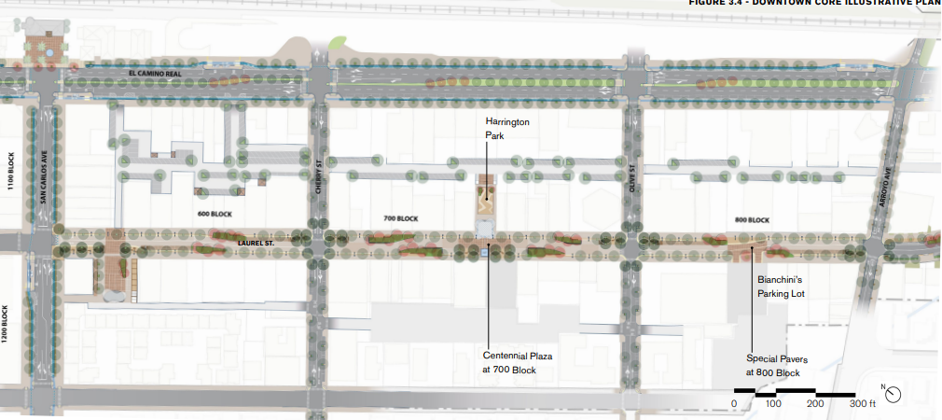
Downtown Core

Slide 17
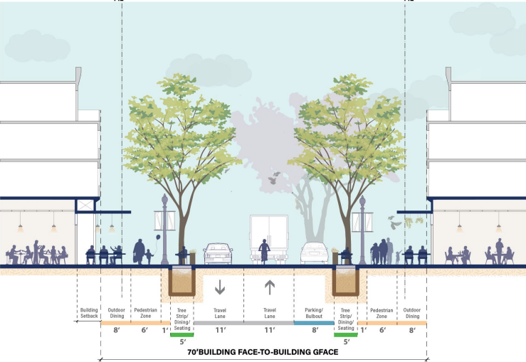
600 & 800 Blocks, Laurel – Prioritize Pedestrian Access
Key Features
Entry plazas (within the sidewalk zone) at the end of each street
20 ft. sidewalks:
- 8 ft. wide outdoor dining zone
- 12 ft pedestrian zone, includes lighting and street trees
Groves/raingardens (green infrastructure solutions)
Public seating
New public plaza at the 600 block
Retractable hydraulic bollards (street closures for events)
1 travel lane in each direction
Multi-use curb zone (e.g. parking)
Facing South

Slide 18
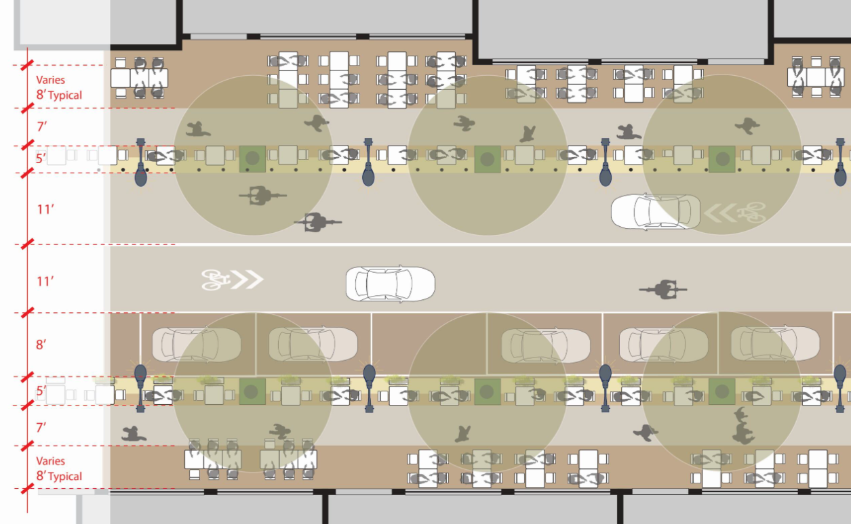
600 & 800 Block, Laurel – Plan View (daily)

Slide 19
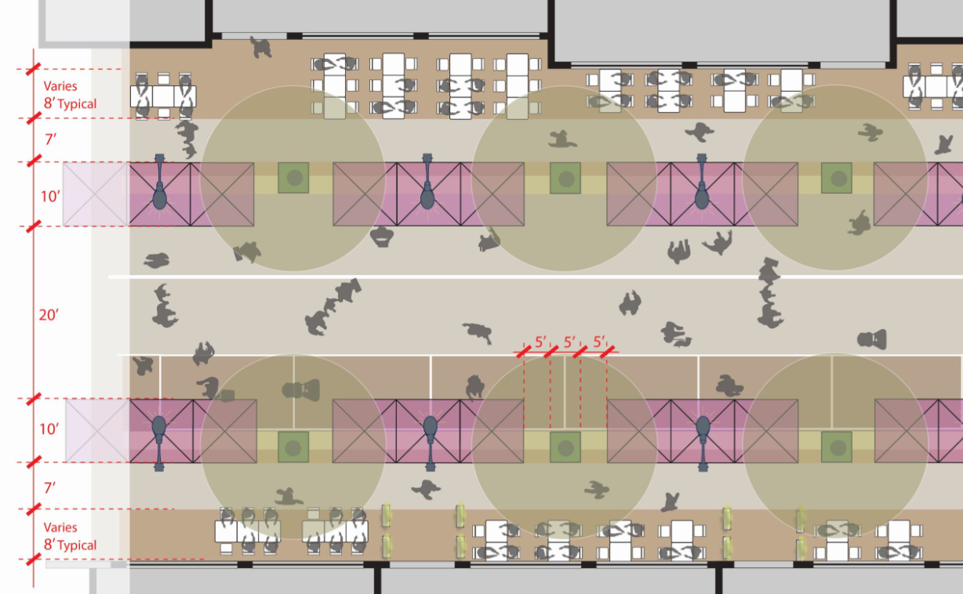
600 & 800 Block, Laurel – Plan View (market)

Slide 20
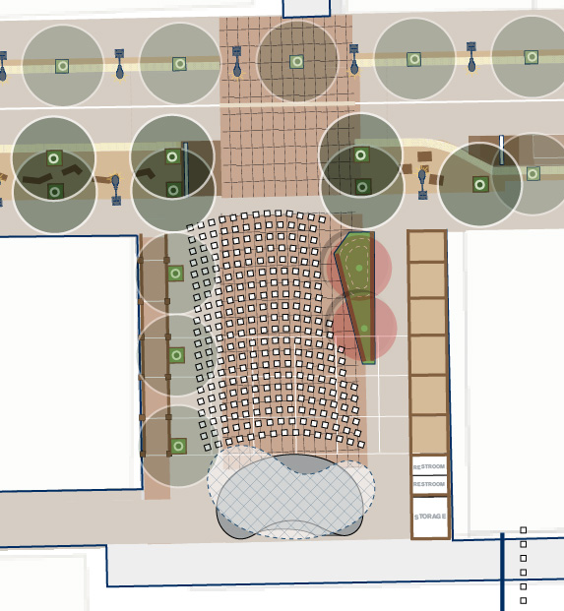
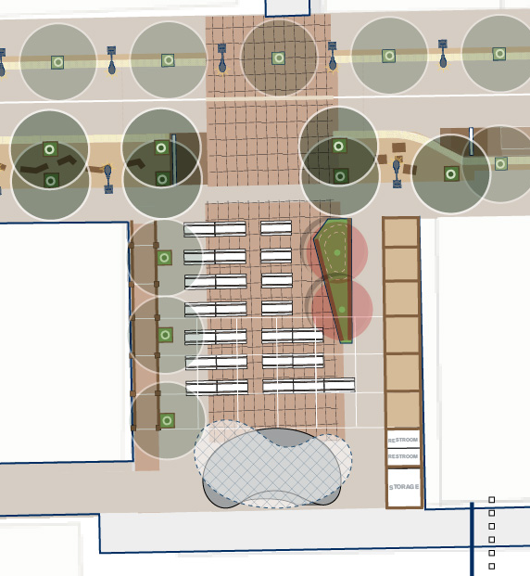
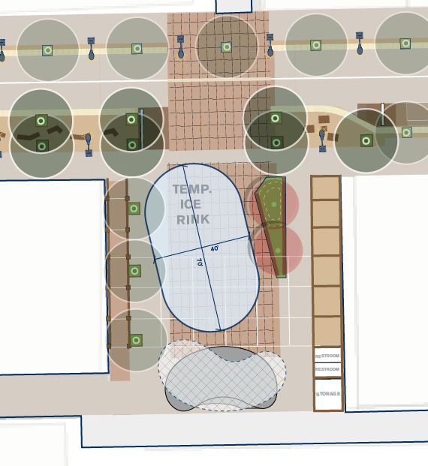
600 Block, Laurel – New Public Plaza Programming Scenarios
CONCERT SCENARIO
BEER GARDEN SCENARIO
WINTER (ICE RINK) SCENARIO
Area of the Plaza: ~ 3645 sq.ft.
Seating Capacity:
Minimum 300 People (7 sq.ft./person)
Maximum 520 People (12 sq.ft./person)
Area of the Plaza: ~ 3645 sq.ft.
Seating Capacity:
Minimum 260 People (14 sq.ft./person)
Maximum 330 People (11 sq.ft./person)
Area of the Plaza: ~ 3645 sq.ft.
Recreational Ice Rink – 40’ x 70’ (2800 sq.ft.)

Slide 21
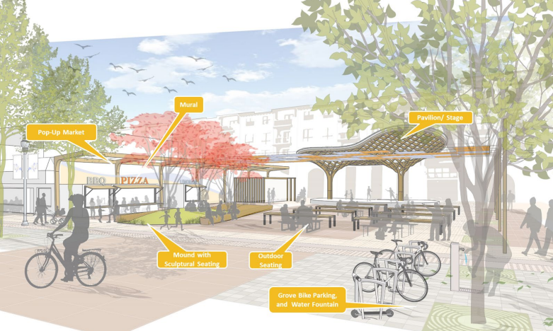
600 Block, Laurel – New Public Plaza Rendering
Key Features
Event space/ programming
Pavilion/stage
Public seating
Drinking fountain
Restrooms
Storage space

Slide 22
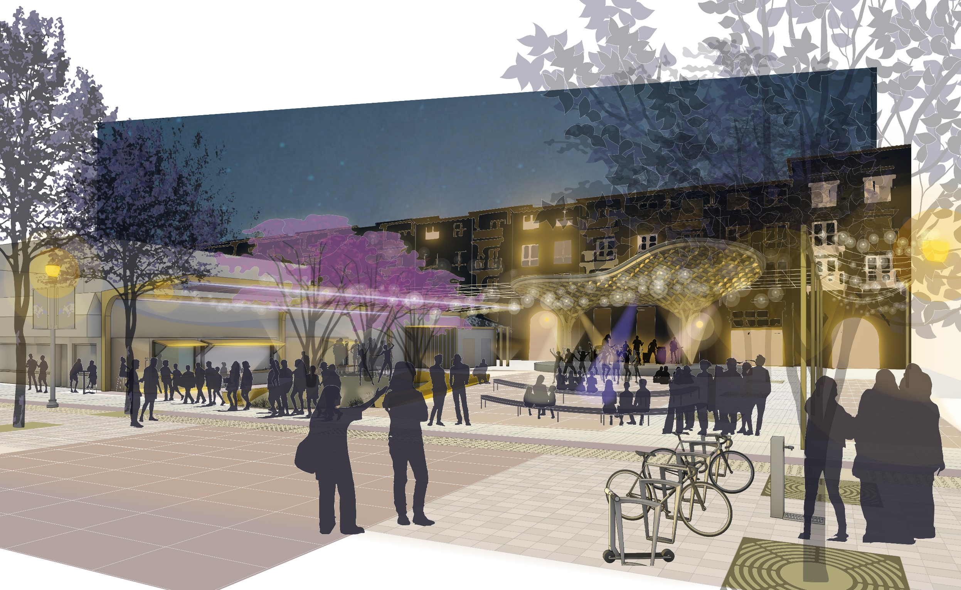
600 Block, Laurel – New Public Plaza Rendering
Concert Scenario

Slide 23
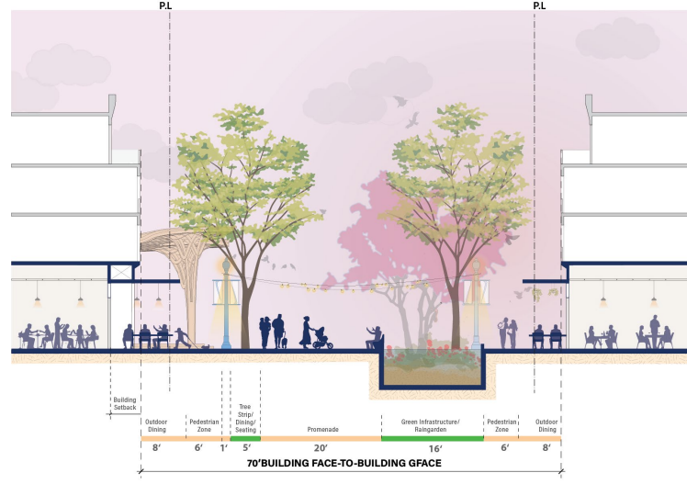
700 Block, Laurel Street – Pedestrian Promenade
Key Features
Full span transformed into a pedestrian plaza
8 ft. wide outdoor dining zone
“Centennial Plaza” at the center
Fountain/water feature
Rain gardens
Tree groves
Harrington Park improvements
Restrooms
20 ft. wide emergency access
Retractable bollards
Facing South

Slide 24
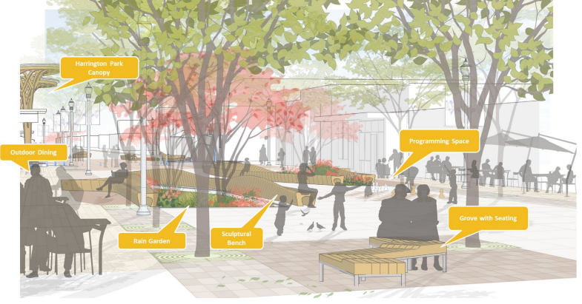
700 Block, Laurel Street - Pedestrian Promenade
Key Features
Entry plazas at opposite ends of the block
Sinuous promenade
Pavilion/stage
Public seating
Murals/Art/Sculpture options

Slide 25
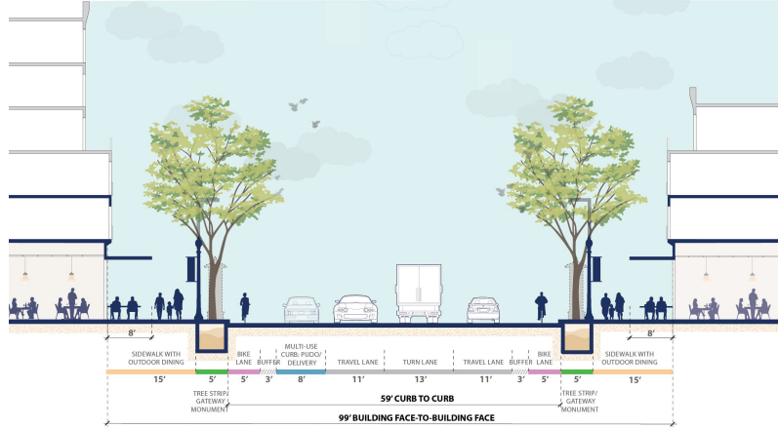
San Carlos Avenue – The Gateway to Downtown
Key Features
20 ft. sidewalks
Protected bicycle lanes
New gateway monument
Multi-use curb lane/zone
Retractable bollards
Public transit integration
Travel lane each direction, with additional center turn lane
Facing El Camino Real | Caltrain Station

Slide 26
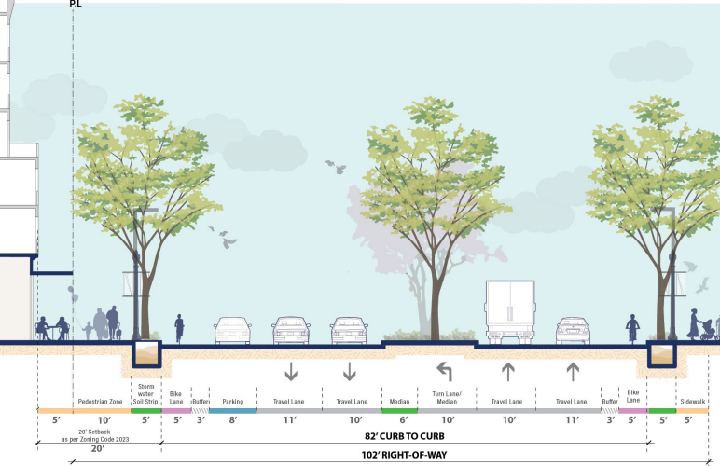
El Camino Real – The Grand Boulevard
Northbound El Camino Real
Key Features
20 ft. sidewalks
Protected bicycle lanes
Parking on west side
Two travel lanes, each direction and turn lane
Public transit integration
“Supports multi-modal transportation by incorporating key elements such as protected bicycle lanes, widened sidewalks, and in-lane bust stop to offer a comprehensive multi-modal experience.”

Slide 27
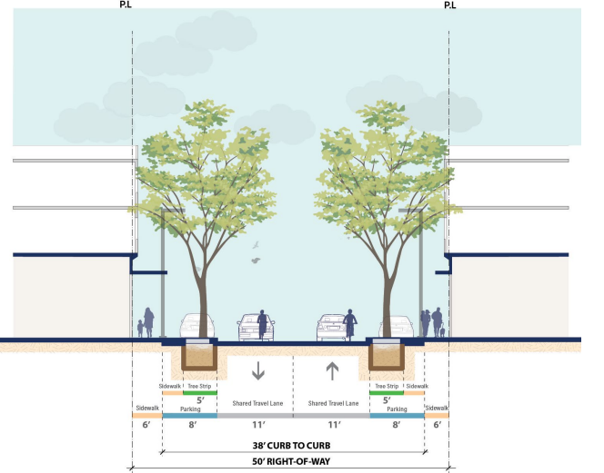
Cherry & Olive Streets – Bicycle and Pedestrian Friendly
Key Features
6 ft. wide sidewalks
New trees and tree grates
Shared bicycle lanes
Parking / Pick-Up Drop Off on both sides
One travel lane each direction
Facing El Camino Real

Slide 28
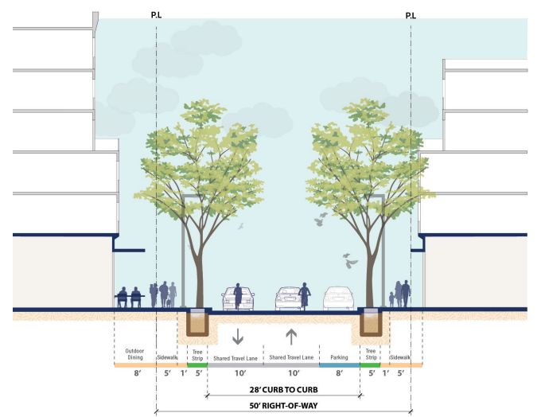
Arroyo Avenue – Bicycle and Pedestrian Friendly
Key Features
Widened sidewalks:
17 ft wide north side
6 ft wide south side
Shared bicycle lanes
Narrowed travel lanes
Speed calming measures
On-street parking
Pick-Up/Drop-Off
Pedestrian and Bicycle connector to the East Side
Facing El Camino Real

Slide 29
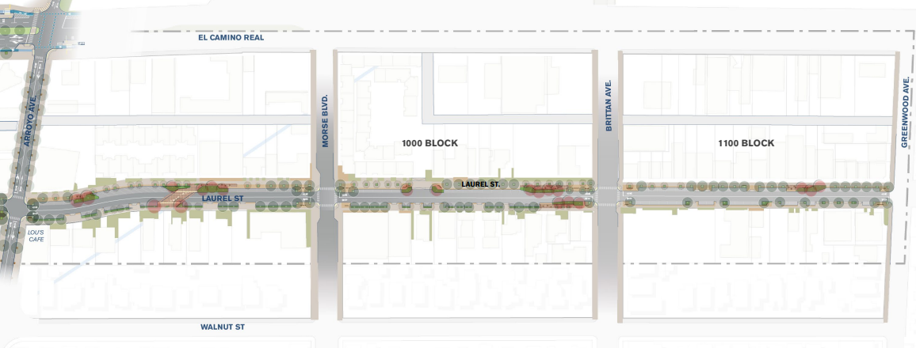
Mid-Laurel and South Laurel (SoLA) Street

Slide 30
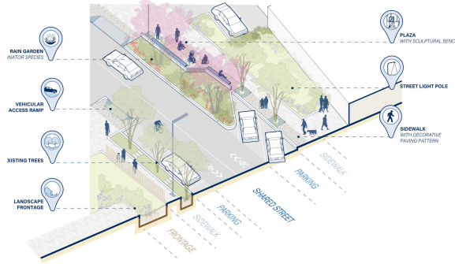
Laurel Street – South of Arroyo
Key Features
Parkway Character with green spaces and tree canopies
Shared travel lanes
Public seating
Green infrastructure
Entry plazas at Morse and Brittan

Slide 31
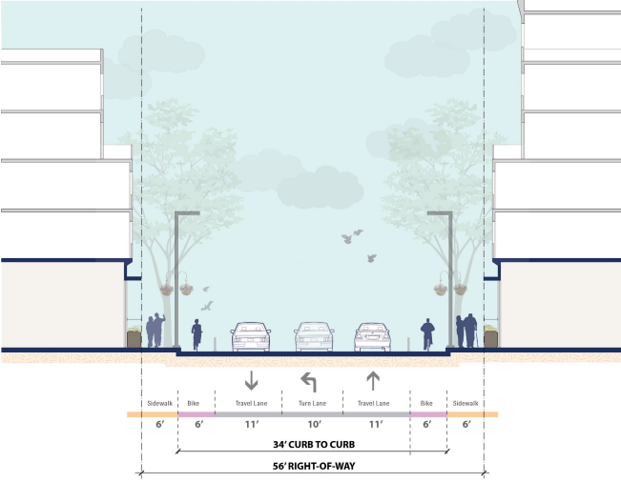
Brittan Avenue – Connector to the East Side and Beyond
Key Features
6 ft wide sidewalks
Dedicated 6 ft wide bicycle lane each direction
1 travel lane each direction
Facing El Camino Real

Slide 32
The Alleys

Slide 33
The Alleys
Alleys serve a dual purpose: access to surface parking and enhance pedestrian, bicycle and vehicular connectivity.
700 Block, Laurel Street
A model for alleys
Improved striping
Secondary business entrances
Service and delivery access
Strategic placement of trash enclosures
Re-Organized Alleys
Re-organization of parking
Screened dumpsters and equipment
Secondary business entrances
Plus
Better lighting
Landscaping
Potential to integrate art elements
…more inviting and multi-functional public space.

Slide 34
Materials, Public Art, Green Infrastructure, Wayfinding
Grand Boulevard Character – El Camino Real
Civic Character – San Carlos Ave and Cherry St
Pedestrian Promenade & Plaza Character – 600, 700, 800 Laurel St + Harrington Park and New Plaza
Parkway Character – Laurel St (South of Arroyo) and Brittan Ave
Public Art – Recommendations to Integrate Public Art in the downtown core streetscape
Green Infrastructure – incorporated throughout all street segments
Wayfinding – builds upon the City’s Wayfinding Project

Slide 35
Grand Blvd Character – El Camino Real
El Camino Real will feature materials that reflect the scale and prominence of this important arterial as it defines the eastern edge of the downtown area. It is characterized by warm tone furnishing and paving, in the darker range of this color palette. Larger metal and natural stone components will be incorporated to convey a sense of civic formality and grandeur.

Slide 36
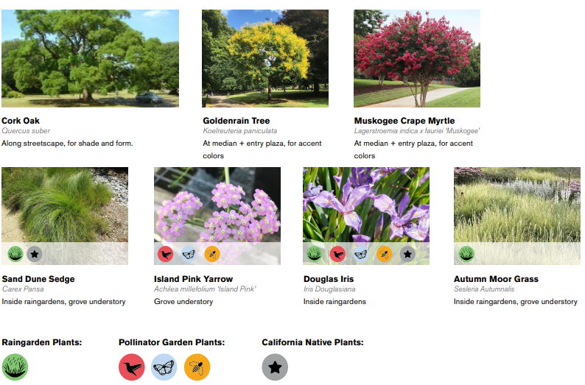
Civic Character – San Carlos Avenue & Cherry Street
San Carlos Avenue and Cherry Street both serve as gateways to the downtown and as primary connector streets to the Civic Center. They share the same material palette with the Grand Boulevard Character, which is characterized by warm tones and a darker color palette.

Slide 37
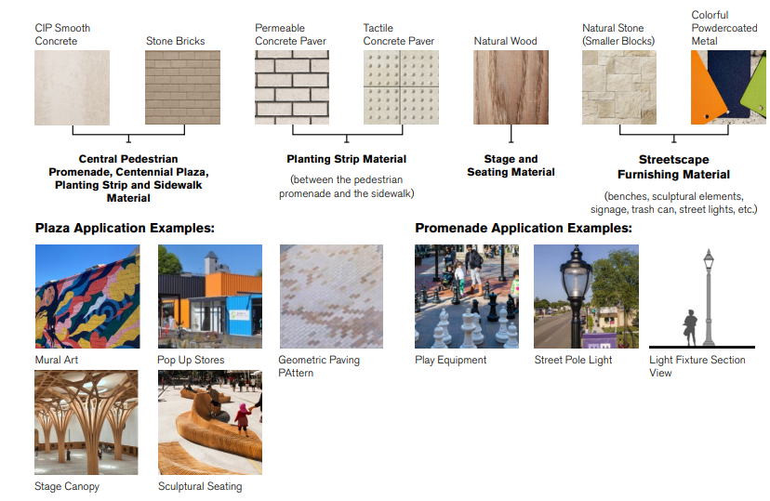
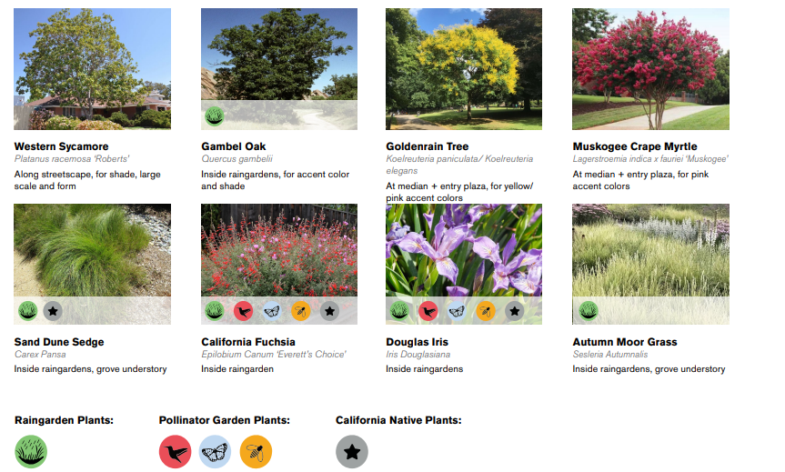
Pedestrian Promenade and Plaza Character
600, 700, and 800 Blocks of Laurel Street + Harrington Park and New Plaza
Distinguished by materials in warm tones and a lighter color palette. Paving patterns incorporate greater variation to enrich the visual and tactile quality of the streetscape. Wooden elements are generously deployed into this character zone to create warm and inviting social atmosphere, highlighted by the custom benches and the pavilion structure at Harrington Park.

Slide 38
Parkway Character – Mid Laurel and SoLa
The Parkway Character focuses on diversifying the tree selections instead of having a unifying species for the entire linear planting strip. Existing trees are kept integral as much as possible, with addition of new trees where shade is lacking, or where additional planting spaces are present such as in the bulb-outs and landscape setback zones.

Slide 39
Public Art
Reflect the City of San Carlos’ unique identity, promote cultural expression, and enhance the public realm by integrating art into key civic spaces, infrastructure, and community hubs.
More platforms for local artists, e.g. season art installations throughout downtown
Sculptures and monuments at key gateways and/or intersections
Incorporate cultural elements – e.g. Sister City concepts
Murals
Locations: Street intersections, plazas and parks, along sidewalks and pedestrian strips

Slide 40
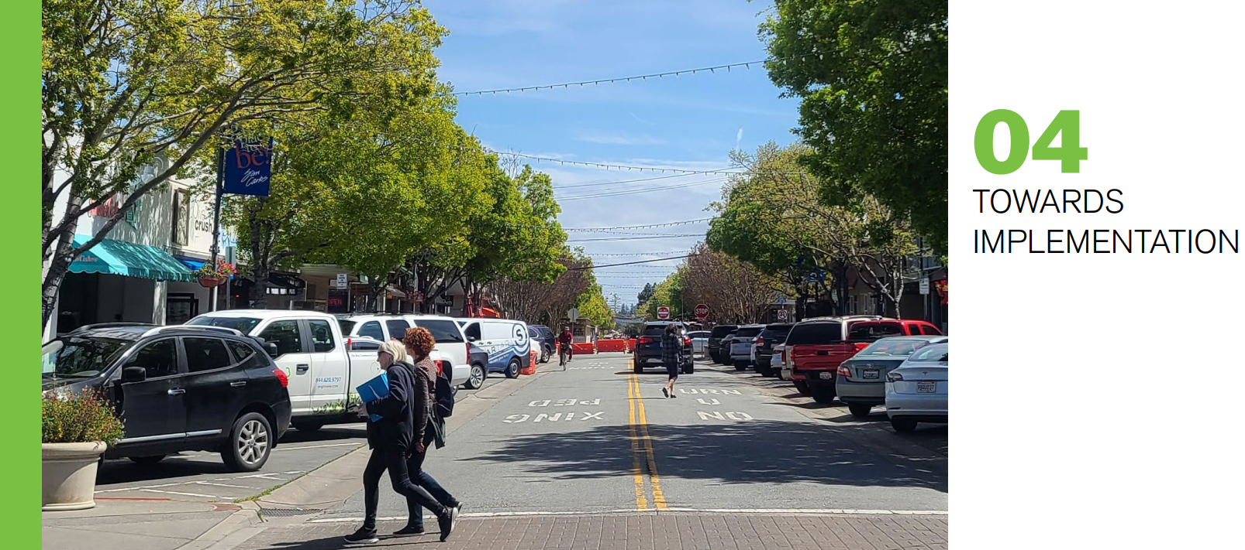
Implementation Chapter - Phasing and Funding

Slide 41
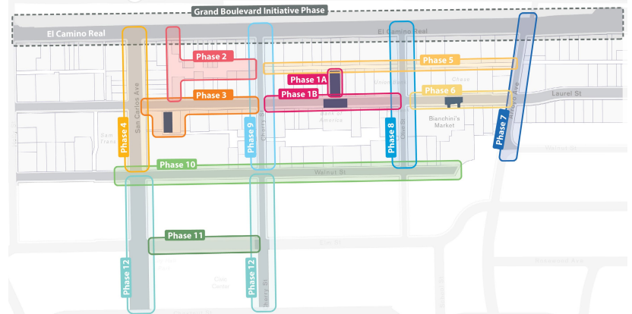
Implementation Chapter
Phasing Strategy
Due to the scale and complexity of the project, the phasing plan is designed to minimize disruptions while ensuring continuous community access. The precise sequencing of the phases will be decided by the San Carlos City Council.

Slide 42
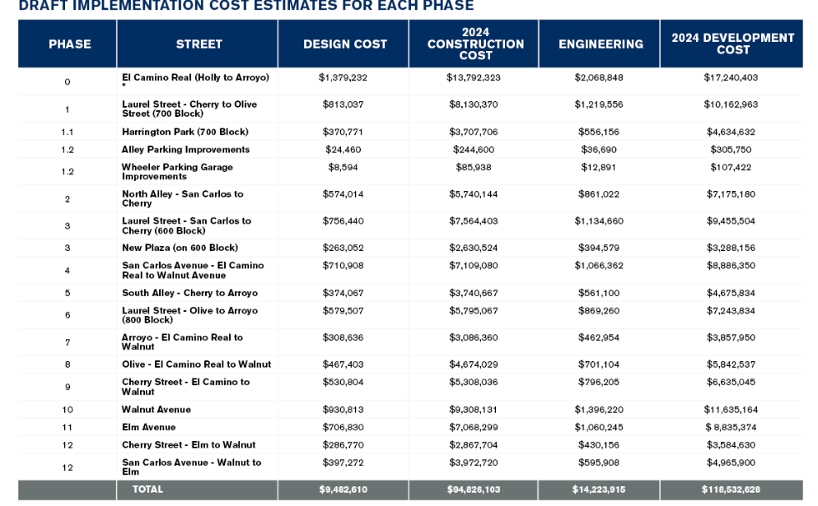
Implementation Chapter
Funding Strategy
Approximate budgets in 2024 dollars needed to implement all phases of the plan.
Realizing this vision hinges on securing adequate funding to cover design, construction, and long-term maintenance costs.
City of San Carlos Funds
Local, State, Federal Funding/Grants
Municipal Bonds
Community Benefit Dollars

Slide 43
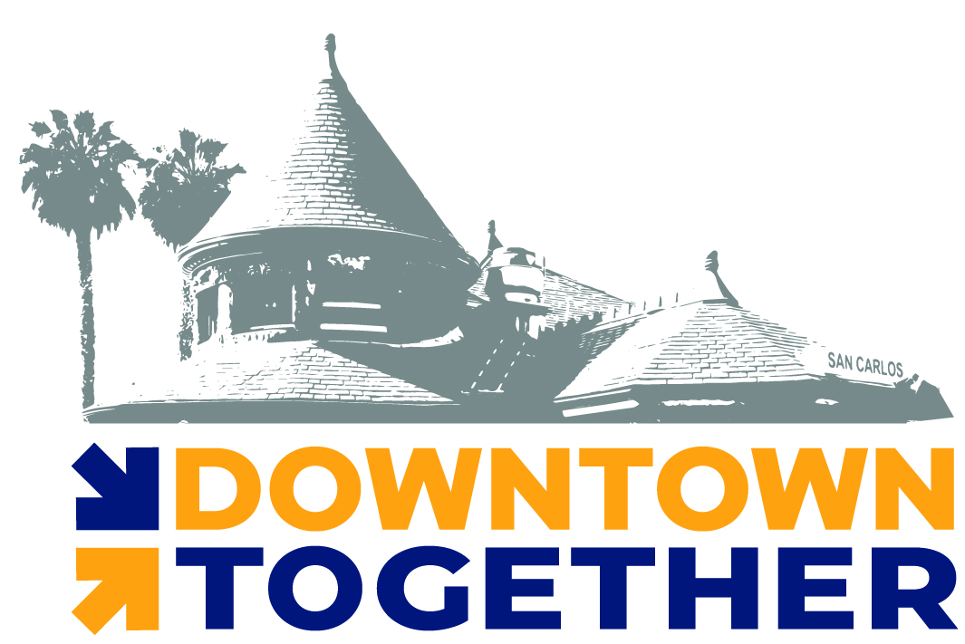
Thank You
A good plan involves everyone!
If you’re participating remotely and would like to make a public comment on this agenda item, use the “raise hand” feature in Zoom.

Slide 44
Next Steps
Continue to prepare Downtown Specific Plan
Summer 2025 – Release Public Draft Downtown Specific Plan
August 18, 2025 – PTC recommendation
September 22, 2025 – City Council adoption
www.sancarlosdowntownplan.com
AdvancePlanning@cityofsancarlos.org

Slide 45
PUBLIC COMMENTS
For downtown streetscape master plan
**CITY COUNCIL MEETING – APRIL 28, 2025**
Two Minute Timer
In the interest of full disclosure,
please note if you are a paid representative/advocate for any item you’ll be commenting on.

